Slide 1

The Quest for Truth:
Detecting Artificially Generated Faces using CNNs
Ryan Kawamura
Alyssa Liu
Sarah Sotoudeh

Slide 2
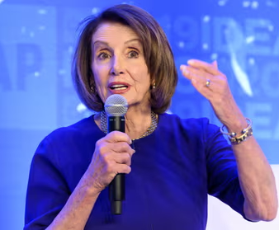


Artificial images threaten to undermine the reliability of visual data
Nancy Pelosi
Tom Hanks
Elon Musk
2019: Video of SOTH intoxicated, stumbling over words at a White House event
2023: Advertisement featuring the actor promoting scam dental plan
2023: Realistic video promoting cryptocurrency scam

Slide 3
Guiding Questions
The motivation of our project

Slide 4
We had three primary questions that guided our project
1.
Can we build a CNN to detect if an artificially altered facial image is fake?
2.
How can we engineer a model that generalizes well to unseen data?
3.
What future work can be done to strengthen our model as Generative Adversarial Networks advance?

Slide 5

01
DATA COLLECTION AND PROCESSING
02
CONVOLUTIONAL NEURAL NETWORKS
03
MODEL DECISIONS
04
RESULTS
05
REFLECTIONS

Slide 6
Data Collection and Processing
Taking a first look at our dataset

Slide 7
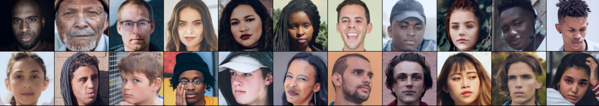
Data was generated by Yonsei University Lab
2,041 face images divided into two classes: fake and real
Fake faces generated by elementary transformations of facial features
Processing: resized images to be the same shape (224 x 224)

Slide 8
Convolutional Neural Networks
Overview of our model

Slide 9
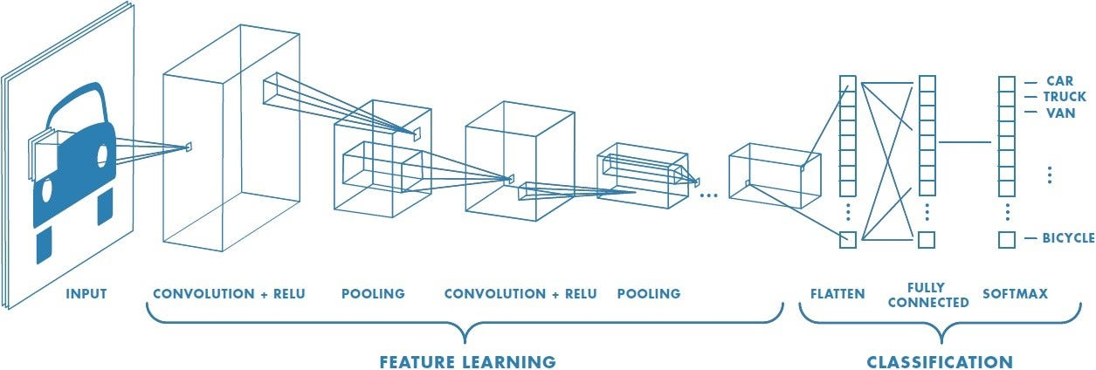
Theory

Slide 10
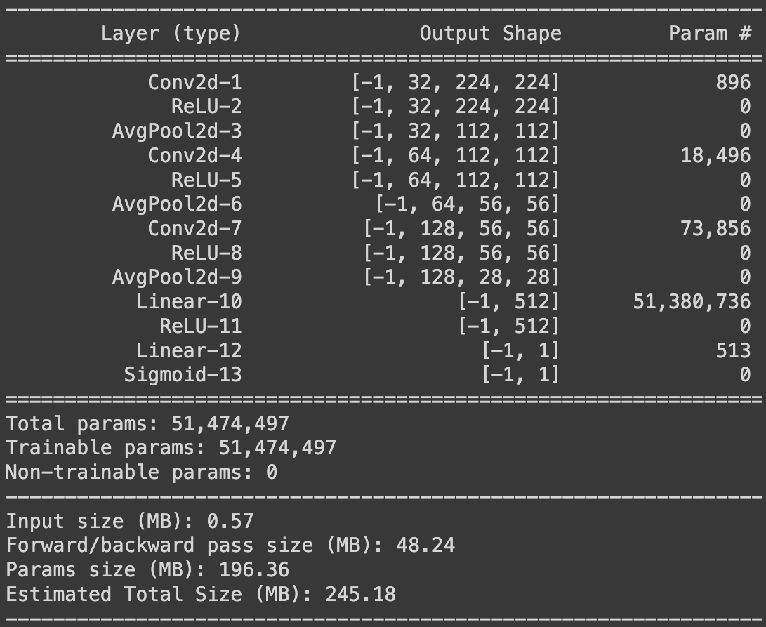
Model Architecture
3 Convolutional Layers
Window size: 3x3
Stride: 1
ReLu activation
3 Average Pooling Layers
Window size: 2x2
Stride: 2
2 Fully Connected Layers
ReLu activation after the first
Sigmoid activation after the second

Slide 11
Model Decisions
Tuning parameters and optimizing accuracy

Slide 12
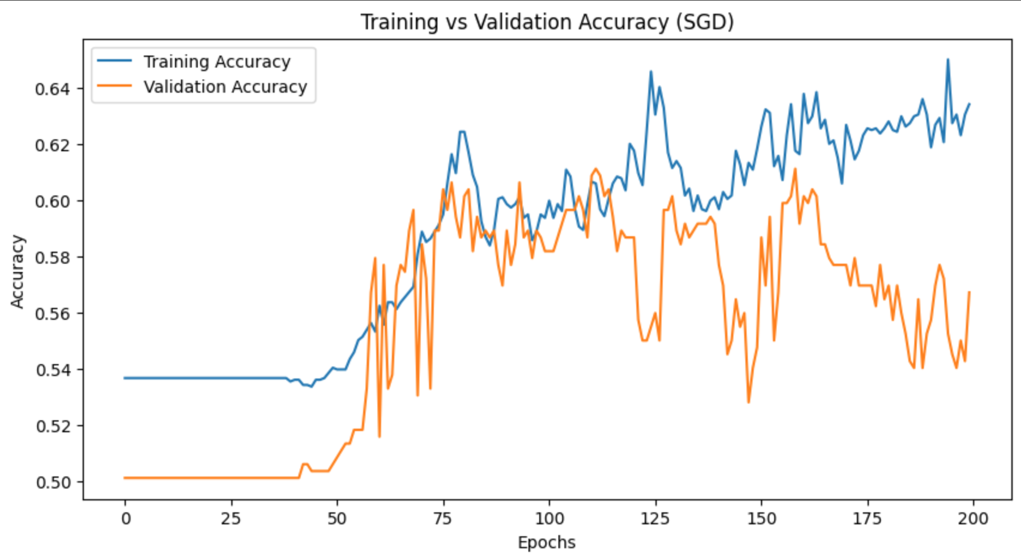
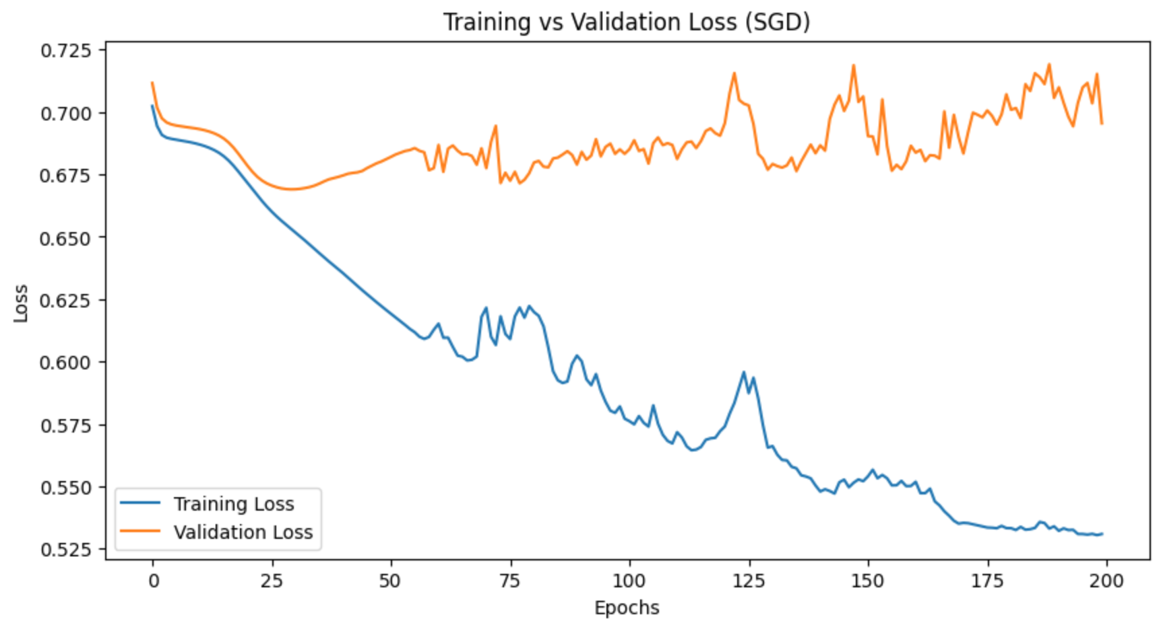
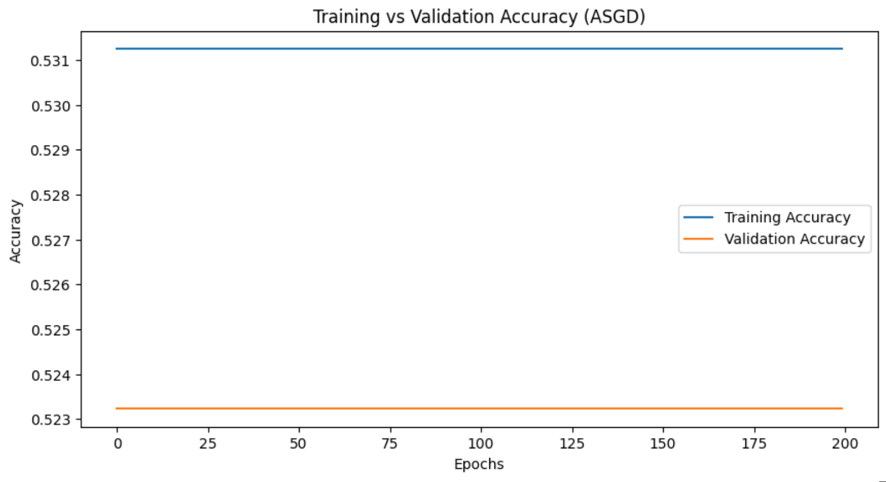
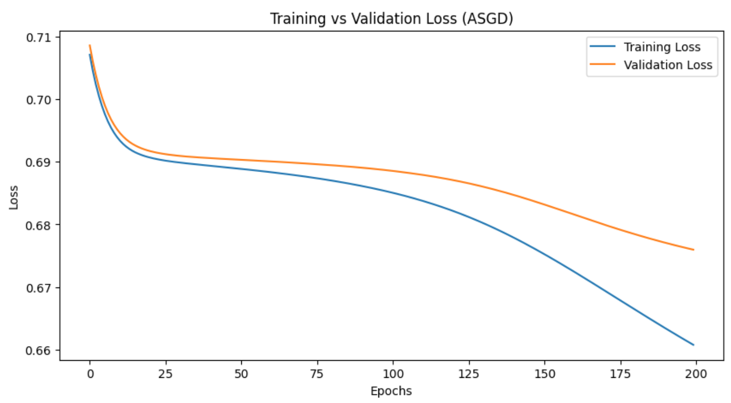
Optimizers
Stochastic Gradient Descent
(SGD)
Averaged Stochastic Gradient Descent
(ASGD)
Notes:
Ryan

Slide 13
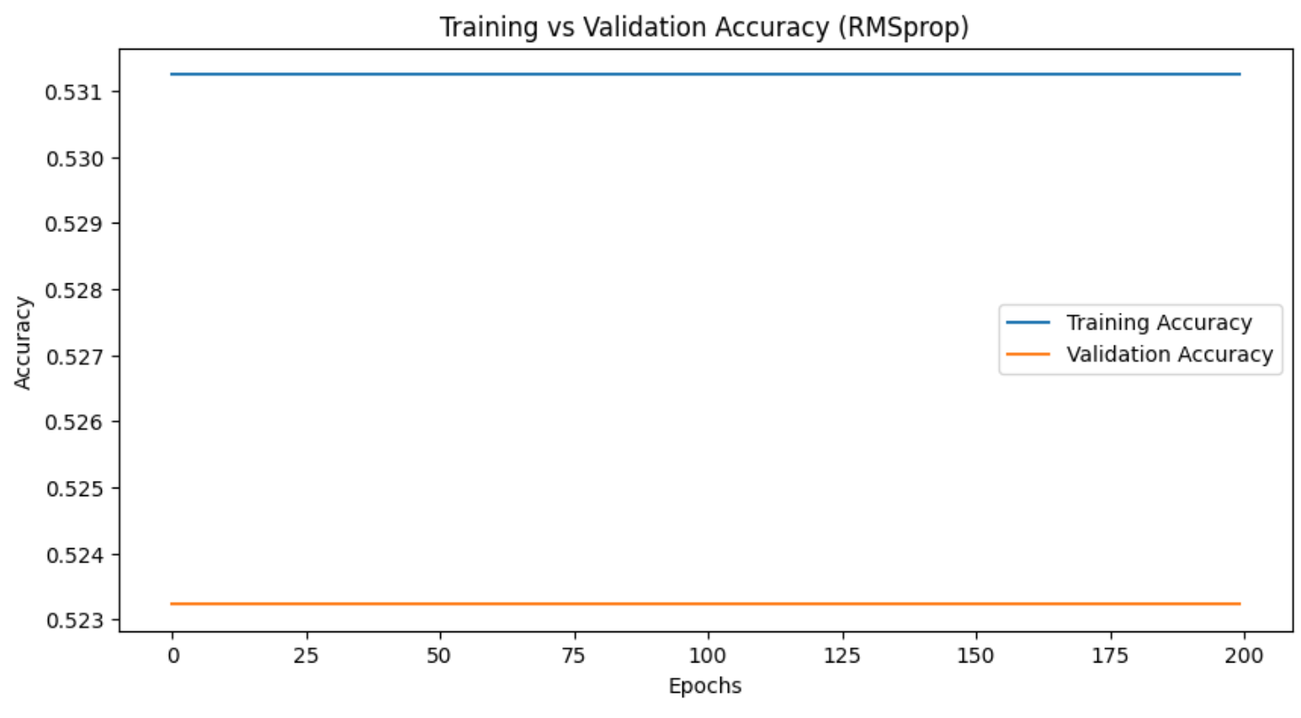
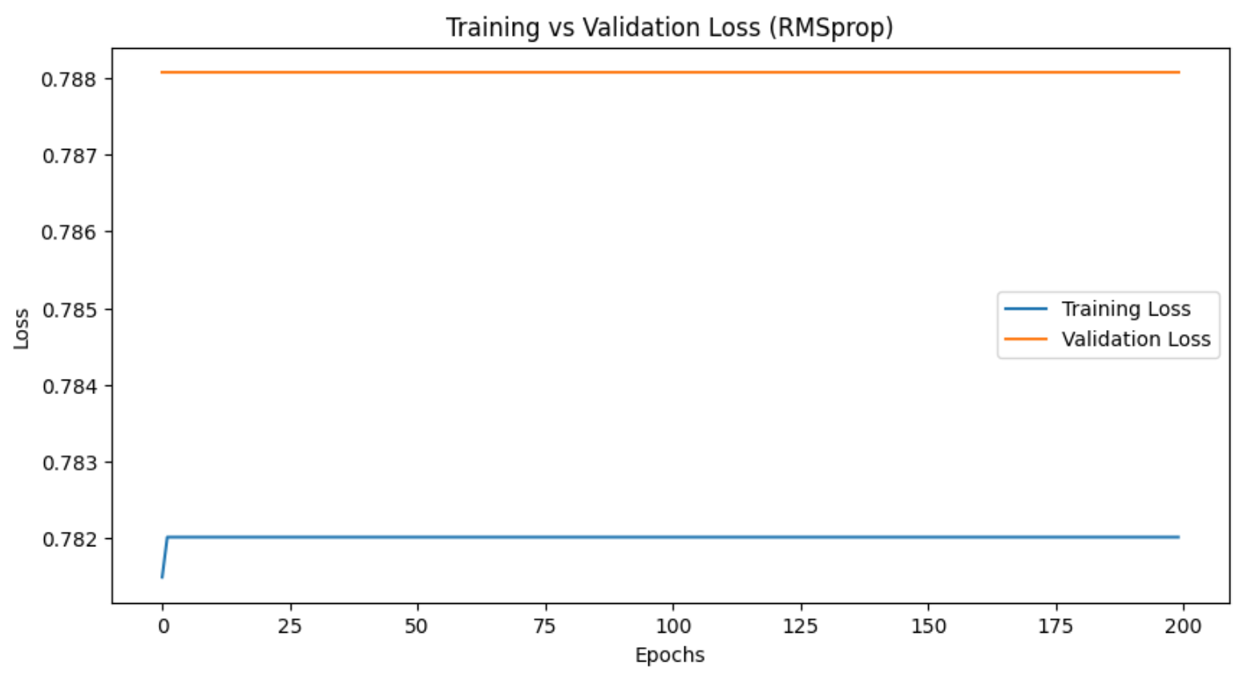
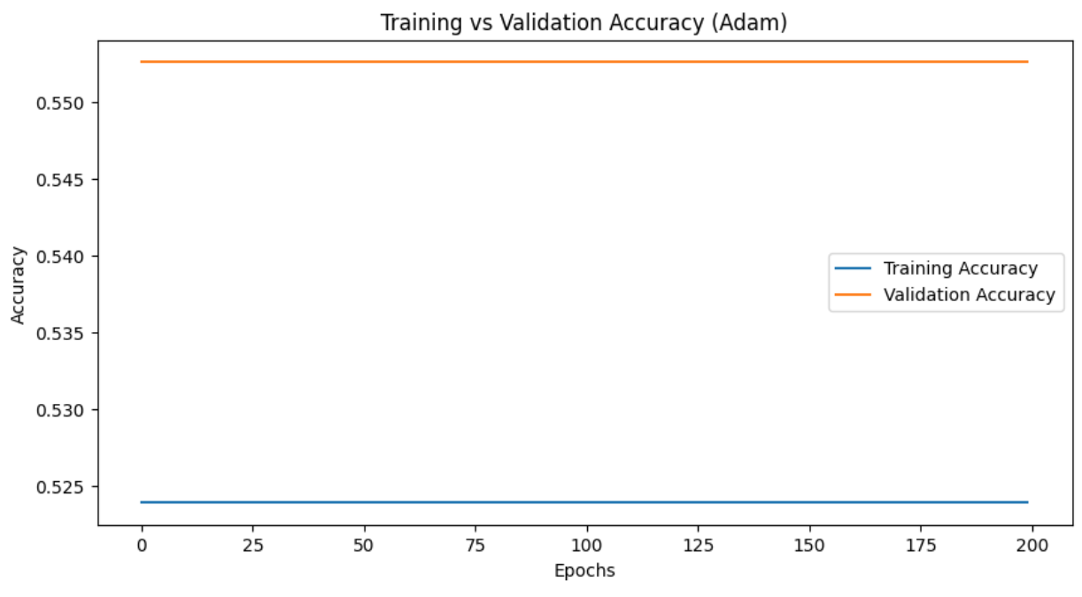
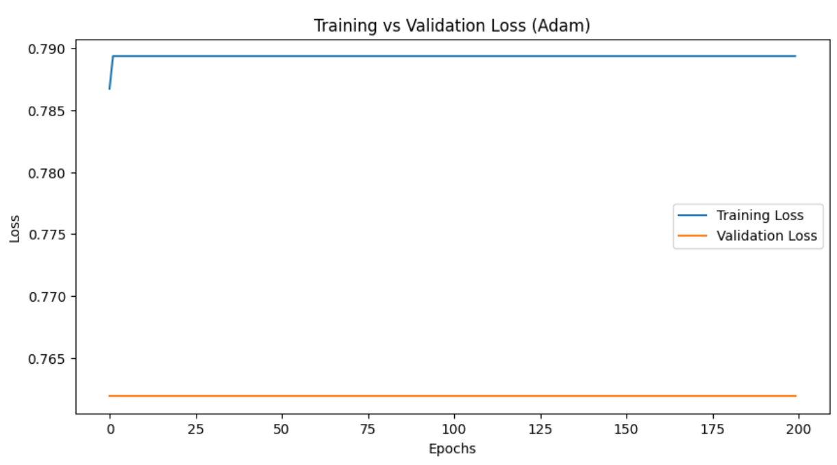
Optimizers
Root Mean Square Propagation
(RMSprop)
Adaptive Moment Estimation
(Adam)
Notes:
Ryan

Slide 14
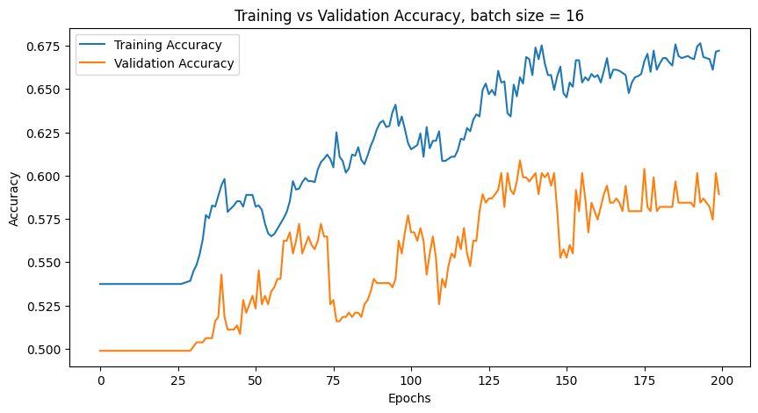
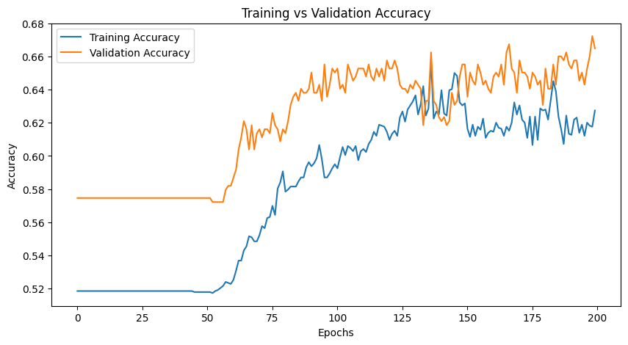
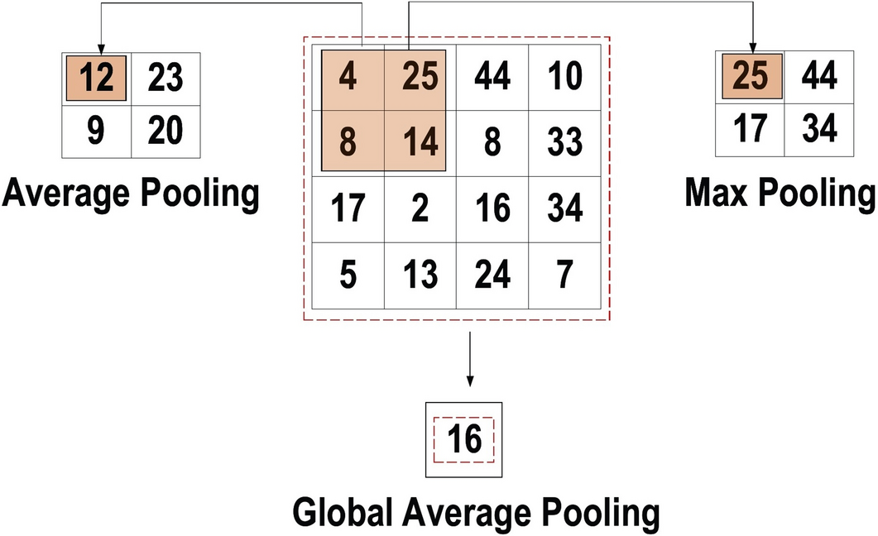
Pooling Type
Max Pooling
Average Pooling

Slide 15
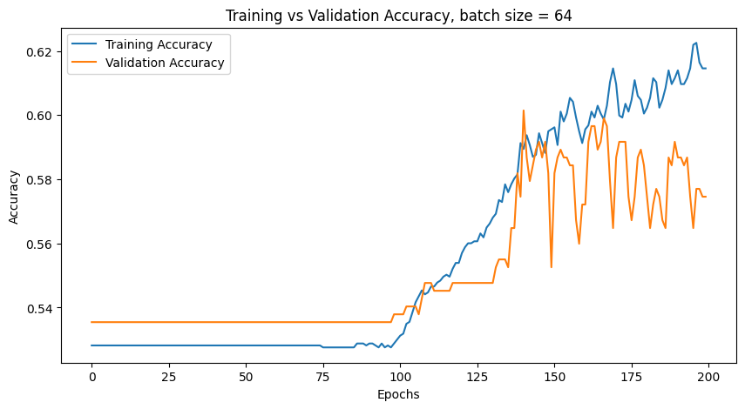
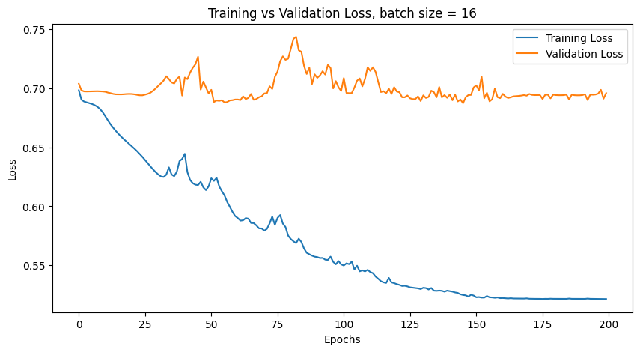
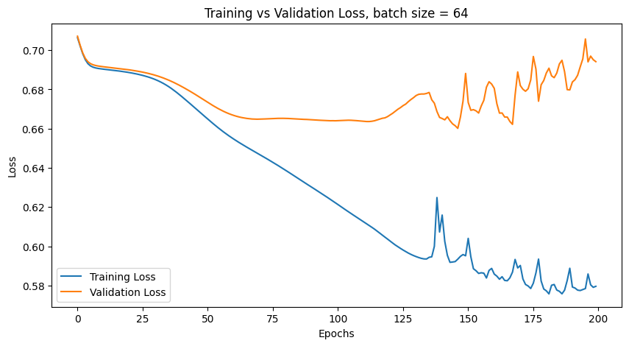
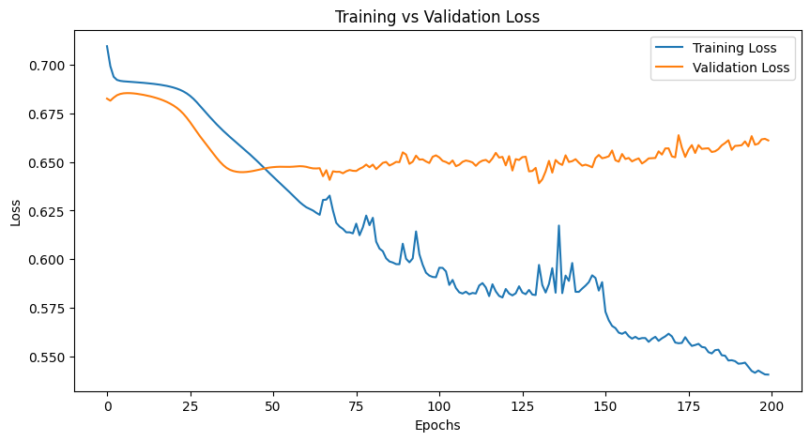
Batch Size: The number of images processed for each iteration of training (forwards + backwards pass)
Batch Size 16
Batch Size 64
Batch Size 32
Notes:
Batch size 16 - still overfitting, even after applying avg pooling instead of max
Batch size 64 - too much variance, try a smaller batch size
Batch size 32 - less variance, still overfitting slightly when you look at the loss curves

Slide 16
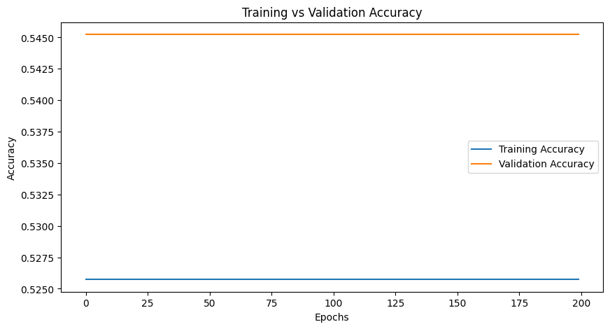
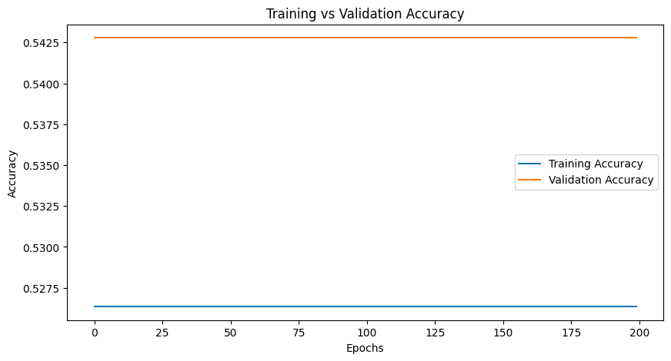
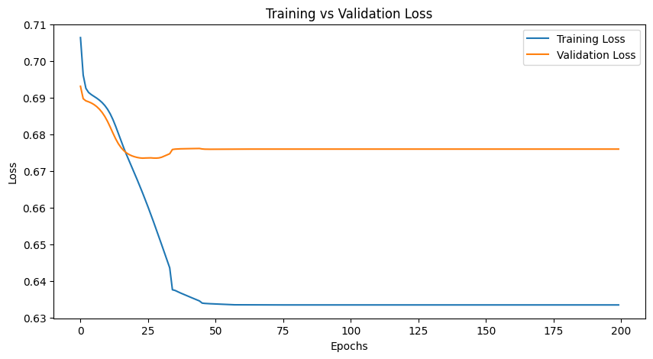
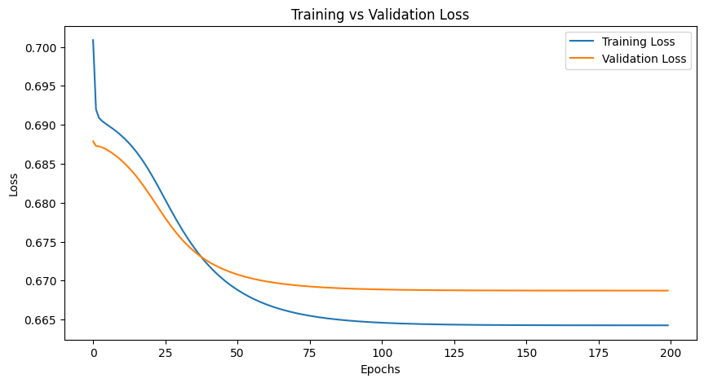
Learning Rate Schedulers: minimal decreases in loss lead to stagnant accuracy
ReduceLRonPlataeu
Exponential Decay
Learning Rate 0.001
Stops updating LR when loss stops improving
Reduces the LR exponentially after each epoch
LR of 0.001 was efficient without overshooting minimum
Notes:
ReduceLROnPlateau: This scheduler reduces the learning rate when loss has stopped improving. It likely did not work because the learning rate may have been lowered too quickly or too slowly, leading to a premature plateau.
Exponential Decay: This scheduler works by reducing the LR exponentially after each epoch. While this approach aims to reduce the learning rate in a controlled fashion, if the rate of decay is not properly calibrated, it can lead to either too slow a convergence or the model might not fully converge to the best solution.
Constant Learning Rate (0.001): This simple approach worked the best for our model, though there is promise in future work exploring other schedulers to trying to optimize results.

Slide 17
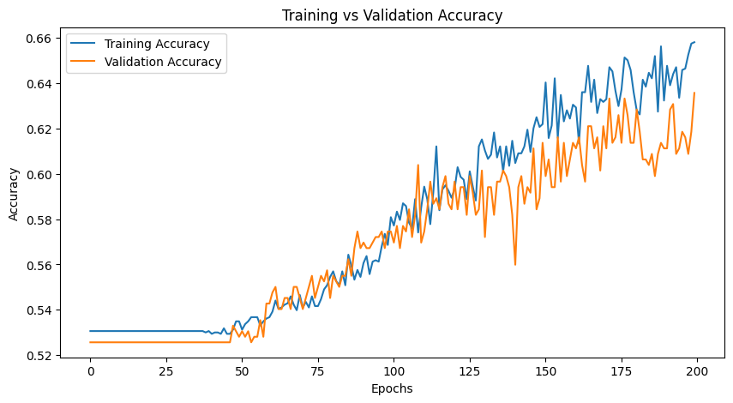
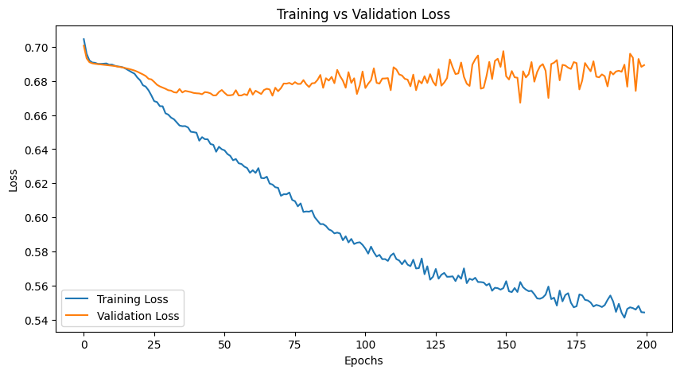
Drop out model still experiences stable validation loss
Drop out
No Drop out
Model might be too simple to benefit substantially from drop out; still observing stable validation loss
Zeros-out 50% of neurons in the first output layer
All neurons activated

Slide 18
Results
Our final model

Slide 19
Final Model
Optimizer: SGD with Momentum
Pooling Type: Avg Pooling
Batch Size: 32
Learning Rate: 0.001
No Drop Out
68% Accuracy
Promising, still considerable error
Issues with overfitting
Notes:
Ryan

Slide 20
Reflections

Slide 21
Limitations & Future Steps
Limitations
Model is overfitting likely due to:
Resource constraints (GPU and computing strength)
Deeper model → more accurate
Dataset size (only 2,041 images)
Differences in real/fake images are not subtle
Fake images created by swapping facial features
Not comparable to deep fakes
Model ⇒ stepping stone
Future Work
Work with video data (where largest threat lies)
Train on a dataset that has more diverse visual data (real-life settings)
Notes:
Ryan

Slide 22
Thank you!
Any questions?

